Slide 1
Knives
The most important tool in the kitchen

Slide 2
Safety
Always use the correct knife for the task at hand
Always cut away from yourself
Always cut on a clean cutting board
Place a damp towel underneath the cutting board to keep it from sliding as you cut

Slide 3
Safety
Keep knives sharp
When carrying a knife, hold it pointed down, parallel and close to your leg as you walk.
A falling knife has no handle
Never leave a knife in a sink of water

Slide 4
Caring for Knives
Washing and drying
Do not wash in commercial dishwashers
Always wash and dry knives by hand

Slide 5
Controlling Knives
Use a grip that is most comfortable for you
Keep the sharp edge of the blade on the cutting board
Use the second joint of your index finger as a guide

Slide 6
Controlling Knives

Slide 7
Types of Knives
Chef’s Knife

Slide 8
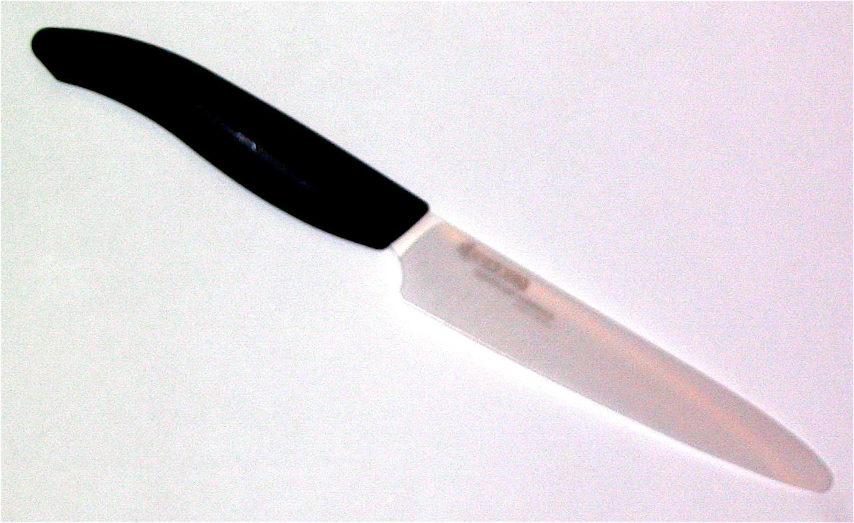
Types of Knives
Utility Knife

Slide 9
Types of Knives
Paring Knife

Slide 10
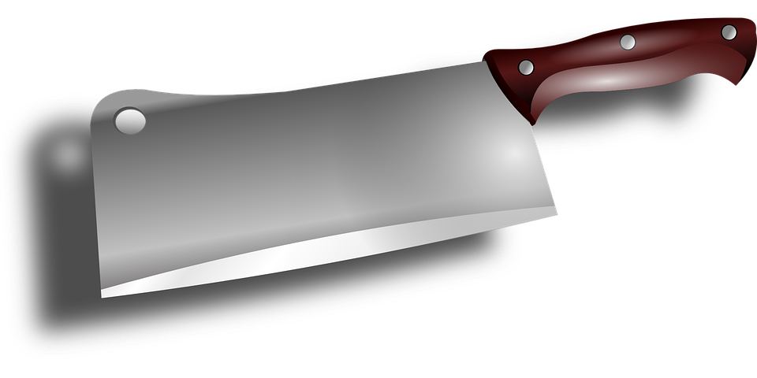
Types of Knives
Cleaver

Slide 11
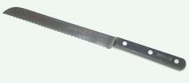
Types of Knives
Serrated Knife (Slicer)

Slide 12
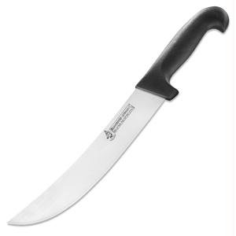
Types of Knives
Scimitar (Butcher)

Slide 13
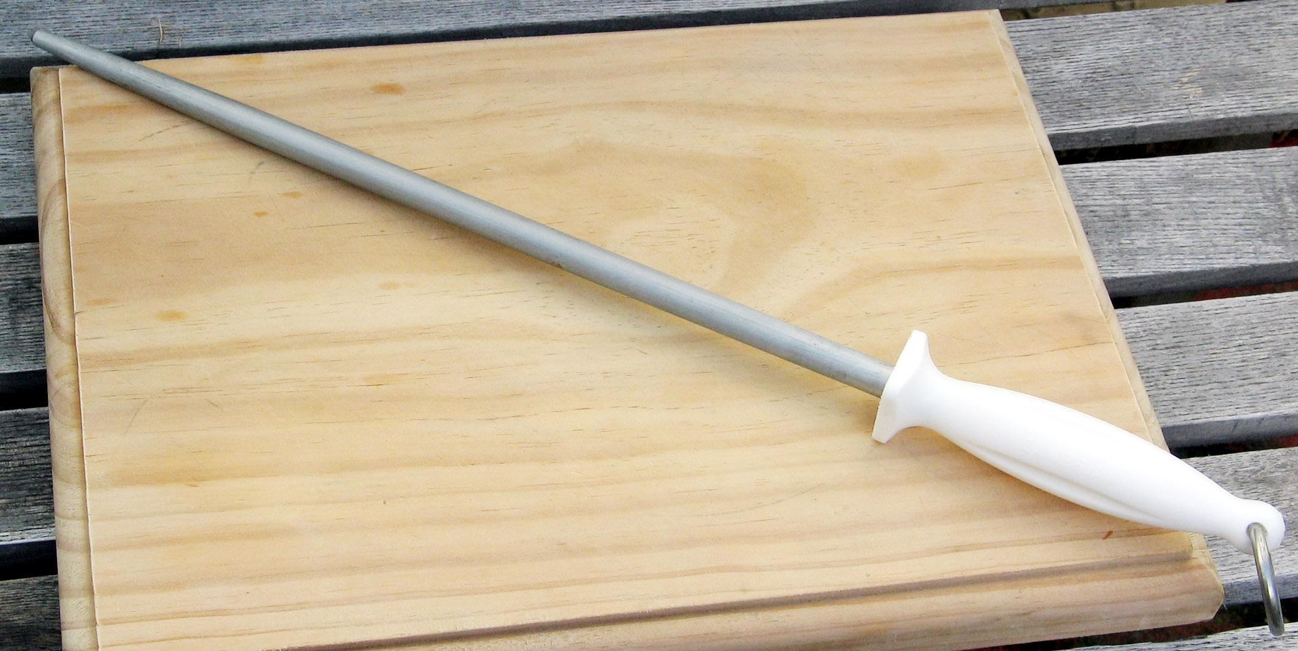
Types of Knives
Sharpening Steel

Slide 14
What not to do in the Kitchen…

